Slide 1

UNIT VI
Input &Output,
File System
Mrs. Payal P. Tayade
SKN SITS, Lonavala.

Slide 2


File Systems
2
We need a mechanism that provides long-term information storage with following characteristics:
Possible to store large amount of INFO
INFO survives after termination of any process
Multiple processes can access INFO concurrently
The file systems is the appearance of INFO from the user’s
standpoint that involved two main structures:
Files
Directories

Slide 3
File System Structures
3
Files - store the data
- logical units of information created by processes
Directories - organize files
▪
- data structure that holds the information regarding files
Partitions - separate collections of directories & files
also called “volumes”
- all directory information kept in partition

Slide 4
Files
4
A file is a logical storage unit defined by the O.S. providing the user a mechanism to store INFO on a physical storage devices such as disk, tape, CD etc.
File is a sequence of bits, bytes, lines or records meaning of which is defined by file creator & user
INFO stored in the files must be persistent, i.e. not be affected by process creation and termination
File has definite structure according to its type

Slide 5
File Types
5
Regular Files: User files (ASCII files or binary files)
Directory Files: System files used to maintain directory structure
Character Special Files: Special system files dedicated to I/O
Block Special Files : Used to model disks

Slide 6
Extension | Meaning
f.bak | Backup File
f.c | C Source Program
f.gic | Graphical Interchange Format
f.hlp | Help File
f.html | Hyper Text Markup Language
f.jpg | Picture Encoded with JPEG Standard
f.mp3 | Music Encoded in MPEG Layer 3 Audio Format
f.mpg | Movie Encoded in MPEG Standard
f.o | Object File
f.pdf | Portable Document Format
f.ps | PostScript File
f.tex | Input for TEX Formatting
f.txt | Text File
f.zip | Compressed Archive(zip means move with high speed)
6

Slide 7
File Attributes
12
Name : symbolic file name kept in human readable form
Identifier : unique tag that identifies file (non human readable form)
Type : what kind of file it is
Location : where the file is physically located
Size: current size of the file (bytes, words or blocks)
Protection: access control, who can read, write, execute etc. the file
Time & Date: when was the last access or modification
User: who created the file

Slide 8
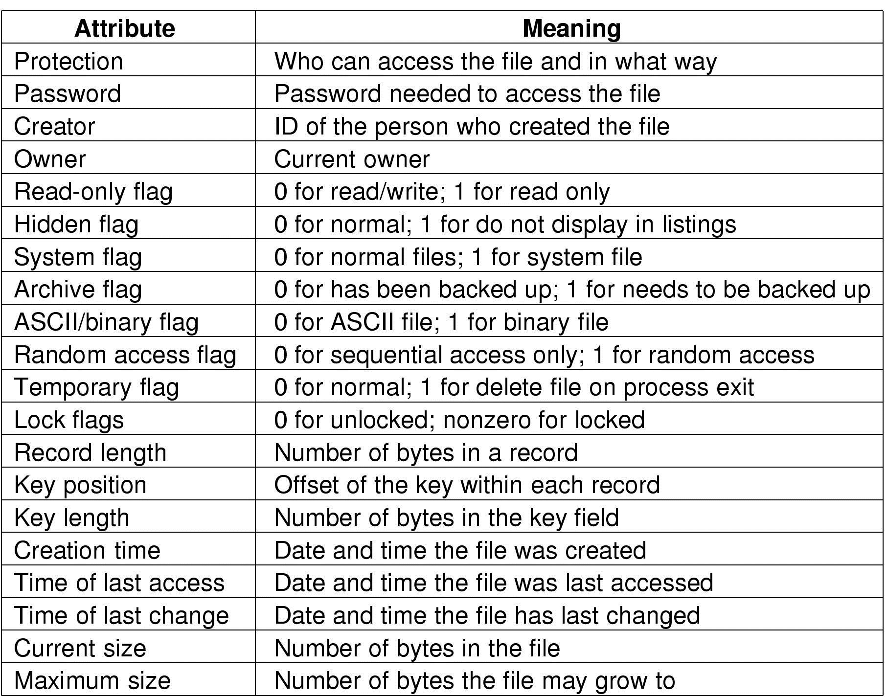
1
3

Slide 9
File Operations
14
Create
Delete
Open
Close
Read
Write
Append
Seek
Get Attributes
Set Attributes
Rename
Lock

Slide 10
File Operations
15
Create
Find space in file system for file
Make entry of new file in directory
Delete
Find directory for named file
Release all file space
Erase directory entry
Open
Fetch address of file into main memory
Check access rights
modify open file table

Slide 11
File Operations
16
Close
Write file back to disk
Remove entry from open file table
Read
Specify name of file
Keep read pointer to location in the file where next read is to take place
Update pointer after reading
Write
Specify file name & information to be written
Keep write pointer to the location in file where next write is to take place
Update write pointer

Slide 12
File Operations
17
Seek
Get the location
Set current file position to given value
Append
Restricted form of write
Adds data to end of file
Rename

Slide 13
Open File
18
Information associated with Open File
File Pointer
Current file-position-pointer to track last read-write location
File Open Count
It tracks number of opens & closes
If last file closed it is set to 0
Disk Location of File
Location of file is kept on main memory instead of reading it each time from disk
Access Rights
Process opens files in access modes
Access-read/write, read only

Slide 14
Storing Files
28
Files can be allocated in different ways:
Contiguous allocation
All bytes together, in order
Linked Structure
Each block points to the next block
Indexed Structure
An index block contains pointer to many other blocks

Slide 15
Contiguous Allocation
29
Files occupy set of contiguous blocks on disk
Defined by address of first block and length
If file is n blocks long and starts at location b then it occupies blocks b, b+1, b+2, ……, b+n-1
File | Start | Length
abc | 0 | 2
imp | 6 | 2
rprt | 12 | 4
synp | 18 | 5
xyz | 27 | 4
abc
imp rprt synp
xyz
0 1
2
3
4
5
6 7
8
9
10
11
12 13 14 15
16
17
18 19 20 21 22
23
24
25
26
27 28 29 30
31

Slide 16
Contiguous Allocation
30
null
File : abc
Start : 0
Size : 2
File Block 0
File Block 1
0
1
File : rprt
Start : 12
Size : 4
null
File Block 0
File Block 1
File Block 2
File Block 3
12
13
14
15
File : xyz
Start : 28
Size : 4
null
File Block 0
File Block 1
File Block 2
File Block 3
27
28
29
30

Slide 17
Contiguous Allocation
31
Pros:
Simple: state required per file is start block and size
Performance: entire file can be read with one seek
Cons:
Fragmentation: external fragmentation is bigger problem
Usability: user needs to know size of file
Used in CDROMs, DVDs

Slide 18


Linked List Allocation
32
File | Start | End
abc | 9 | 30
Each file is stored as linked list of blocks
If a file contains 7 blocks that consists of blocks 9, 6, 15, 17, 24, 25, 30
If each block is of 512 bytes & disk address requires 4 bytes then user sees block of 508 bytes
Each block consists of pointer to the next block
If the pointer is empty it indicates end of file
0
1
2
3
4
5
6
7
8
9
10
11
12 |  | 13 |  | 14 |  | 15
16 |  | 17 |  | 18 |  | 19
20 |  | 21 |  | 22 |  | 23
24 |  | 25 |  | 26 |  | 27
28 |  | 29 |  | 30 |  | 31

Slide 19
Linked List Allocation
33
File Block 0
File Block 1
File Block 2
File : abc
Start : 9
9
6
15
null
File Block 3
File Block 4
File Block 5
File Block 6
17
24
25
30

Slide 20
Linked List Allocation
34
Pros:
No space lost to external fragmentation
Disk only needs to maintain first block of each file
Does not need to compact disk
Cons:
Cannot support direct access
Sequential access less efficient (seek, latency)
Overheads of pointers
Less reliable (if any of the pointer is lost linking fails)

Slide 21
Indexed Allocation
35
Each file owns index block
Index block contains pointers to each data block
File
Index Block
abc
19
0 |  | 1 |  | 2 | 3
4 |  | 5 |  | 6 | 7
8 |  | 9 |  | 10 |  | 11
12 |  | 13 |  | 14 |  | 15
16 |  | 17 |  | 18 |  | 19
20 |  | 21 |  | 22 |  | 23
24 |  | 25 |  | 26 |  | 27
28 |  | 29 |  | 30 |  | 31
1
9
12
6
30
25
-1
-1
i entry in the index block
th
points to the i^{th} block of file

Slide 22
Indexed Allocation
36
Pros:
No space lost to external fragmentation
Size declaration not required
Supports direct access
Cons:
Overheads of pointers is higher
Entire block is wasted for pointers
file size limited by number of index entries

Slide 23

Directories
39
Directories stores the information related to files
Directories keep track of files
Directories contains information such as
File name
Location
Size
Type
Directory
Files
Partition A
Directory
Files
Partition B
Directory
Files
Directory is viewed as symbol table that translates file names into directory entries
Partition C

Slide 24
Directory Operations
40
Search
Get entry for particular file
Create
Create & add new files to directory
Empty directory contains dot and dotdot files
Delete
Only empty directory can be deleted
Open
Directory must be open before read(readdir)
Close
Directory is closed to free internal table space

Slide 25
Directory Operations
41
Read
Returns next entry in open directory(readdir)
Link
Linking allows file to appear in more than one directory
Unlink
If file being unlinked is present in only one directory it is removed from file system. If it is present in multiple directories only the path specified is removed.
Rename
Directories are just like file & can be renamed
Traversing the FS
Contents & structure of every directory is saved at regular intervals
Useful in case of system failure

Slide 26
Directories
42
Parent directory
The containing directory
Subdirectory
The directory being contained
Directory tree
A logical view of a file system; a structure showing the nested directory organization of a file system
Root directory
The directory at the highest level
Working directory
The subdirectory in which you are currently working

Slide 27
Directory
43
Drive D
Directory
Documents
Directory
Chapter01.ppt
……
Chapter06.ppt
Files

Slide 28
Single-Level Directory
44
One directory for all files in the volume
Called root directory
Used in early PCs
Data | Mail | Test | Record | Hex
Directory
A.ppt B.doc C.txt
D.doc
E.obj
Files
Pros: simplicity, ability to quickly locate files
Cons: inconvenient naming (uniqueness, remembering all)

Slide 29
Two-Level Directory
45
Each user has a separate directory
User 1
User 2 User 3
Master Directory
Data
Mail
Test
Record
Hex
Program
Backup
User Directory
A.ppt
B.doc
C.txt
D.doc
E.obj
F.C G
Files
Solves name collision, but if user has lots of files it becomes difficult to manage files
May not allow a user to access other users’ files

Slide 30
Tree-Structured Directory
46
Directory is a tree of arbitrary height
Directory contains files and subdirectories
A bit in directory entry differentiates files from subdirectories

Slide 31
Union
Best
Set
Root Directory
Data
Mail
Test
Record
Hex
Program
Backup
Sub Directory
Files
Count
Read
Write
Find | Look | Trace | Follow | Wait
Sub Directory
Files
Low
High
Sub Directory
Files
47

Slide 32

Disk Space Management
48
Concept of Free Disk Block
Methods of Disk Space Management
1) Linked List
2) Bit Map

Slide 33
Disk Space Management
48
Linked List
0
1
2
3
4
5
6
7
8
9
10
11
12
13
14
15
16
17
18
19
20
21
22
23
Head

Slide 34
Disk Space Management
48
2) Bit Map
- 0 for free block
- 1 for allocated block
- Disk with free location 2,5,7,9,13,19,21 (for previous
diagram), bit map can be given as
1101101010111011111010

Slide 35
48
Thank
You

